Slide 1
Increase number of discounted products, keep discount levels
Group 3: Joachim, Ngoc, Yusuf, Florian
Notes:
In this presentation we want to show you why it can be advantageous to sell some products at a specific discount.

Slide 2
Big picture
Intensive data cleaning
Lot of maintenance
Notes:
In order to get to there, we had to do a lot of data cleaning and maintenance of the data.

Slide 3

Big picture
Intensive data cleaning
Lot of maintenance
For the Future:
Increase data consistency
Include release date
…
Notes:
On a side note for future improvement to data collection: Among including other factors for describing products, we propose an increasement of the overall data consistency.
But back to our big picture…

Slide 4
Big picture
Categorical distribution
Total revenue
Discount distribution
Seasonality
Notes:
After cleaning we were able to get insight into the categorical distribution, what are the characteristics of our total revenue, the discount distribution and how different months contribute to total revenue.

Slide 5
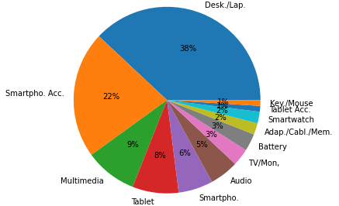
Distribution of product categories
Notes:
To actually see what we offer, we classified our products into 12 categories. The distribution reveals that the majority of products we offer in our portfolio are related to high priced desktop and laptop computers. Therefore, we should have an eye on this large category. As we are interested in our discount price strategy, we have to look into how these different categories, and especially the desktop/laptop category are discounted. Are we discounting the higher priced Apple products?

Slide 6
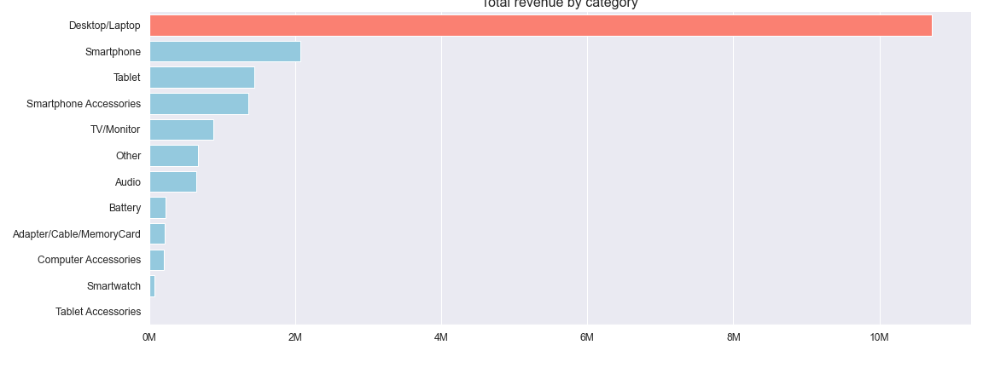
Categories’ revenues
Notes:
As we just identified the desktop/laptop category as the product class of interest, we can see that this huge category generates the vast majority of sales revenue with more than 10 million euros. However, this large number could be associated with an overproptionally large number of sold products and be confounded with discounts.

Slide 7
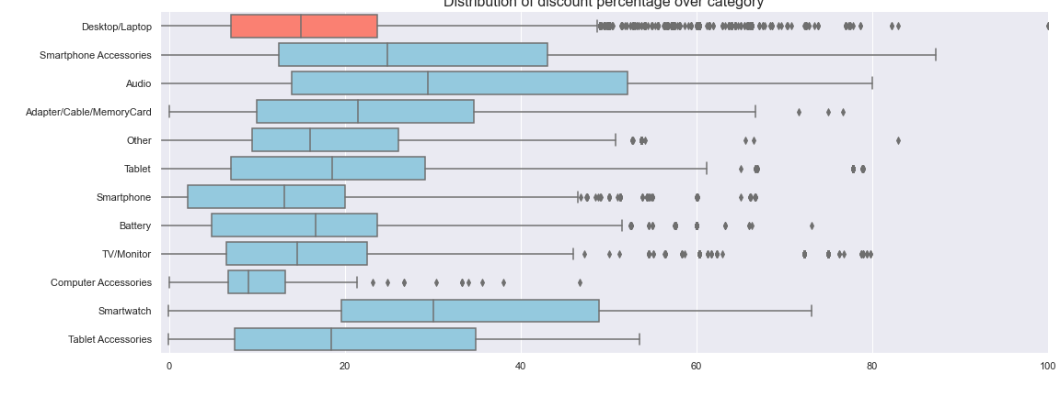
Category discounts in %
Notes:
But if we look at the distribution of discounts in %, we can see for the category we are mainly interested in — that is high price Apple computers — that we offer only a rather narrow range of discounts from less than 10 % to up to about 25 %. What we are now interested in is the total revenue and how discounts influence that.

Slide 8
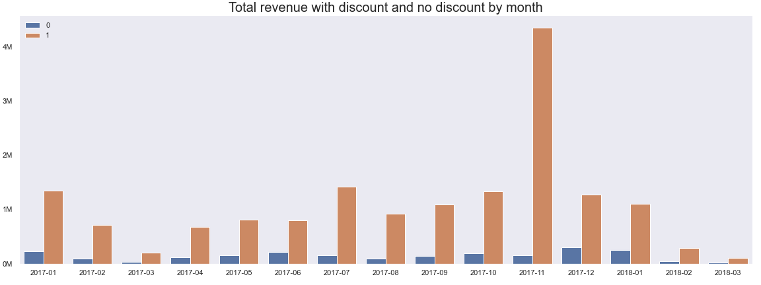
Monthly total revenue for non-/discounted products
Non-discounted
Discounted
Notes:
Looking at total revenue by month, we can clearly see that the black friday, cyber monday season and the overall christmas shopping in november contributes to a stark increase of revenue due to discounted products. At the same time non-discounted products do not significantly change the revenue over the year.

Slide 9
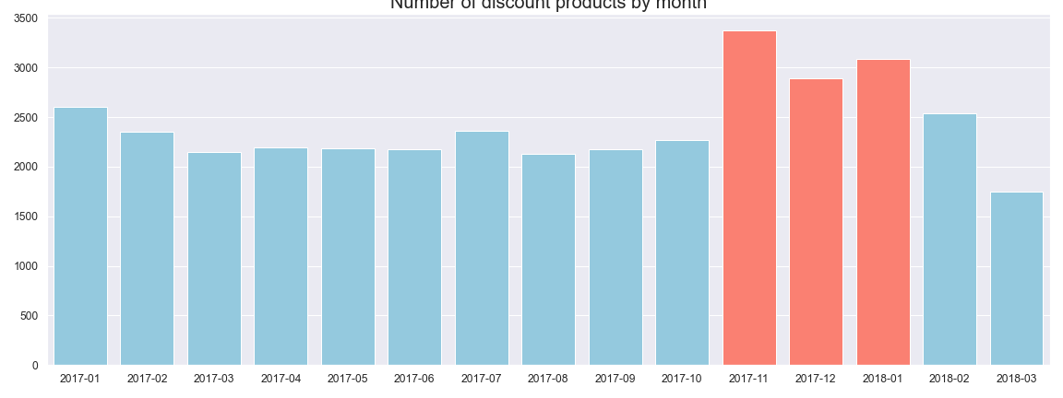
Monthly discounted products
Notes:
(Number of discounts products by month)
The main reason for november’s increase in revenue is the increase of number of discounted products.

Slide 10
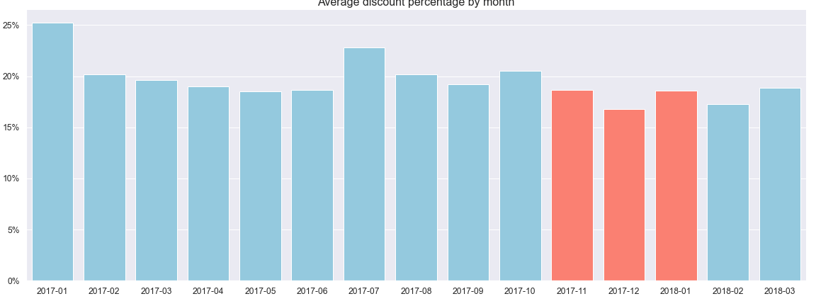
Monthly discount in %
Notes:
(Average discount percent by month)
Interestingly, november’s high revenue was NOT due to an increase of the discount levels.

Slide 11
Conclusion
Increase number of discounted products
Do not increase the discount levels
Notes:
As we can from November where the revenue was so high, grating discounts for more products will result in higher sales and revenue. We therefore suggest, in order increase revenue, to increase the number of discounted products. However, the we do not advise discounting the high price, high volume category of Apple desktop laptop computers because it generates high revenue even with a low discount.

Slide 12
Thank you!
Notes:
In this presentation we want to show you why it can be advantageous to sell some products at a specific discount.

